Slide 1
Transaction Management
Motivation

Slide 2
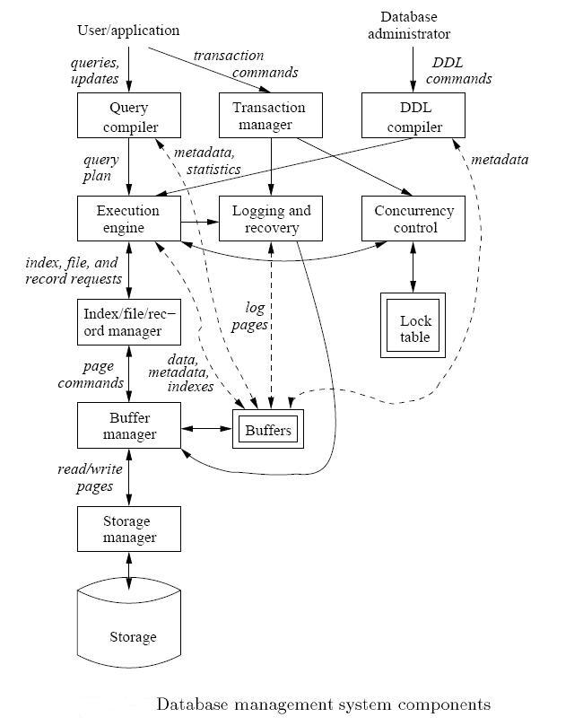
DBMS Backend Components
Our next focus

Slide 3
Transactions
A transaction = sequence of operations that either all succeed, or all fail
Basic unit of processing in DBMS
Transactions have the ACID properties:
  A = atomicity
  C = consistency
  I = independence (Isolation)
  D = durability

Slide 4
Goal: The ACID properties
A tomicity: All actions in the transaction happen, or none happen.
C onsistency: If each transaction is consistent, and the DB starts consistent, it ends up consistent.
I solation: Execution of one transaction is isolated from that of all others.
D urability: If a transaction commits, its effects persist.

Slide 5
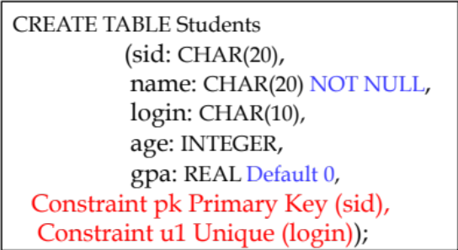
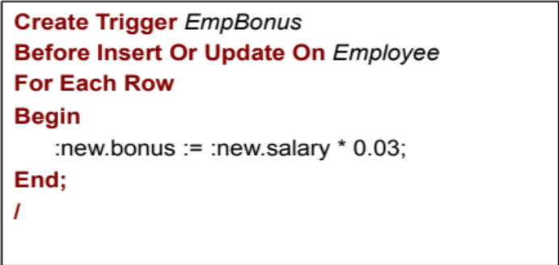
Integrity & Consistency Constraints
Define predicates and constraints that the data must satisfy
Examples:
  - x is key of relation R
  - x → y holds in R
  Domain(x) = {Red, Blue, Green}
  No employee should make more than twice the average salary
Defining constraints
Schema-level
Add Constraint command
Business-constraint
Use of Triggers

Slide 6
Concurrent Transactions
T1
T2
T3
Tn
DB
(consistency
constraints)
Many transactions access the data at the same time
Some are reading, others are writing
May conflict

Slide 7
Transactions: Example
T1: Read(A) T2: Read(A)
A ← A + 100 A ← A × 2
Write(A) Write(A)
Read(B) Read(B)
B ← B+100 B ← B × 2
Write(B) Write(B)
Constraint: A=B
How to execute these two transactions?
How to schedule the read/write operations?

Slide 8
A Schedule
An ordering of operations (reads/writes) inside one or more transactions over time
What is correct outcome ?
Leads
To
What is good schedule ?

Slide 9
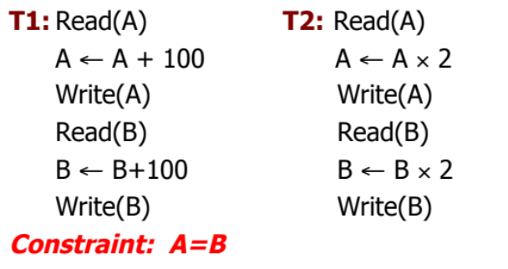
Schedule A
T1 T2
Read(A); A ← A+100
Write(A);
Read(B); B ← B+100;
Write(B);
Read(A);A ← A×2;
Write(A);
Read(B);B ← B×2;
Write(B);
A B
25 25
125
125
250
250
Serial Schedule: T1, T2
250 250

Slide 10
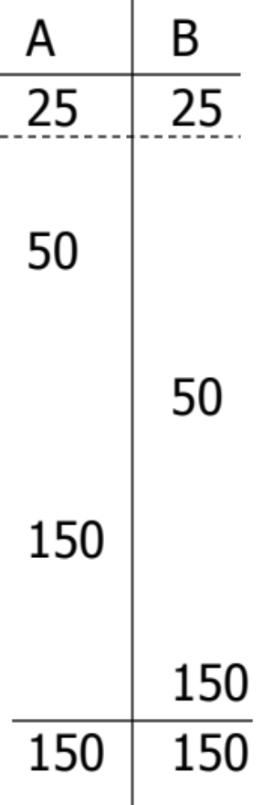
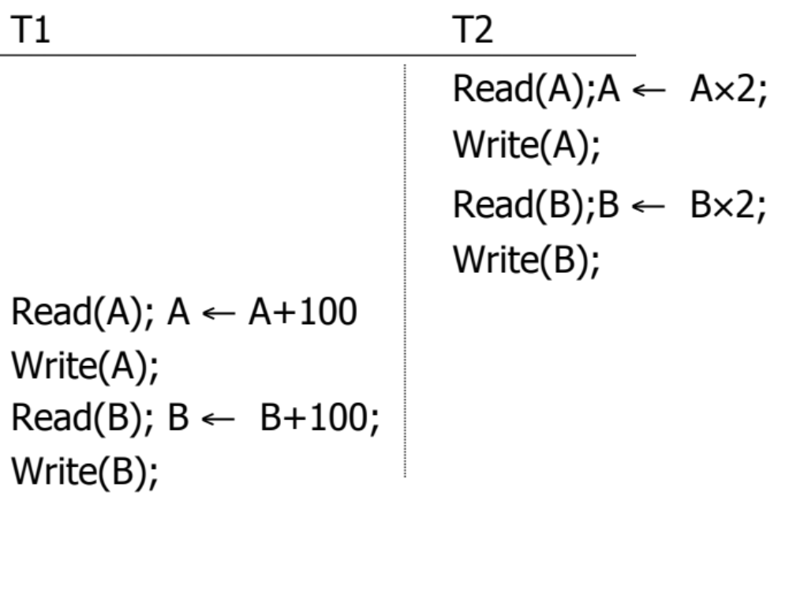
Schedule B
Serial Schedule: T2, T1

Slide 11
Serial Schedules !
Definition: A schedule in which transactions are performed in a serial order (no interleaving)
The Good: Consistency is guaranteed
➔Any serial schedule is “good”.
The Bad: Throughput is low, need to execute in parallel
Solution ➔ Interleave Transactions in A Schedule…

Slide 12

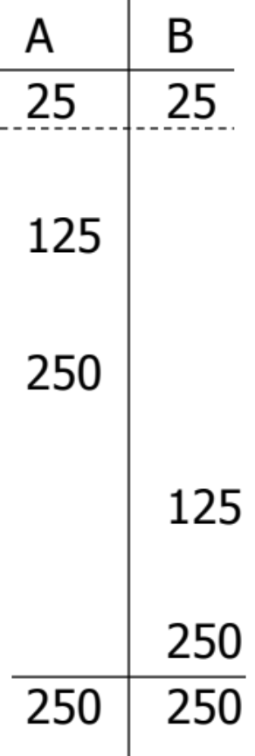
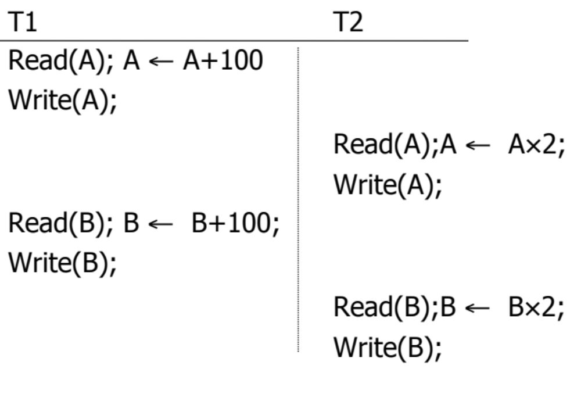
Schedule C
Schedule C is NOT serial but it’s Good

Slide 13
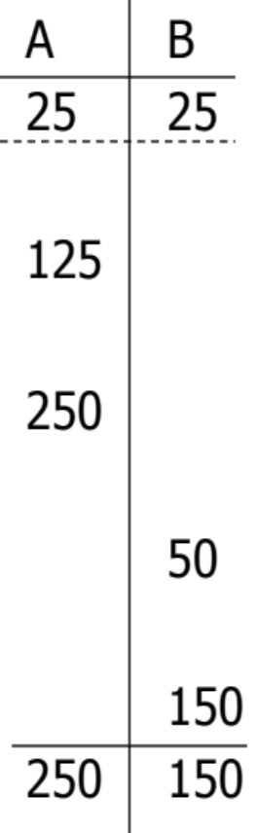
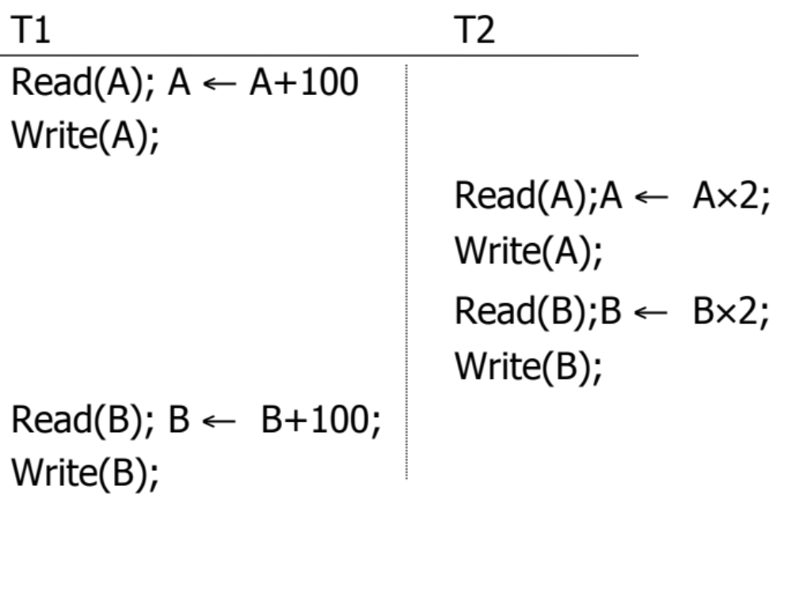
Schedule D
Schedule D is NOT serial and it’s Bad
Not Consistent

Slide 14
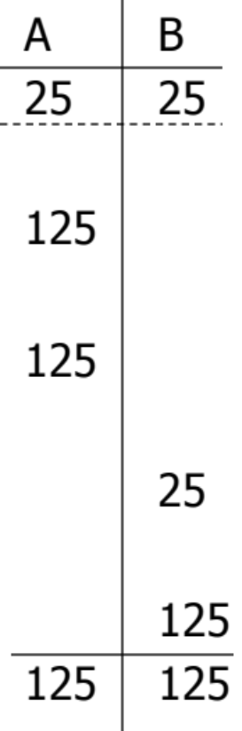

Schedule E
Same as Schedule D
but with new T2’
Same schedule as D, but this one is Good
Consistent

Slide 15
What Is A ‘Good’ Schedule?
Does not depend only on the sequence of operations
  Schedules D and E have the same sequence
  D produced inconsistent data
  E produced consistent data
We want schedules that are guaranteed “good” regardless of:
  The initial state and
  The transaction semantics
Hence we consider only:
  The order of read/write operations
  Any other computations are ignored (transaction semantics)
Transaction semantics played a role
Example:
Schedule S =r1(A) w1(A) r2(A) w2(A) r1(B) w1(B) r2(B) w2(B)

Slide 16
Example: Considering Only R/W Operations
Schedule S =r1(A) w1(A) r2(A) w2(A) r2(B) w2(B) r1(B) w1(B)

Slide 17

Concept: Conflicting Actions
Conflicting actions: Two actions from two different transactions on the same object are conflicting iff one of them is write
r1(A) ←→ W2(A)
➔ Transaction 1 reads A, Transaction 2 write A
w1(A) ←→ r2(A)
➔ Transaction 1 writes A, Transaction 2 reads A
w1(A) ←→ w2(A)
➔ Transaction 1 writes A, Transaction 2 write A
No Conflict
r1(A) ←→ r2(A)
➔ Transaction 1 reads A, Transaction 2 reads A
Conflicting actions can cause anomalies…Which is Bad

Slide 18
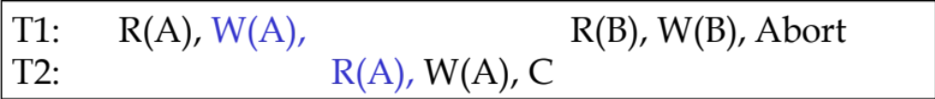
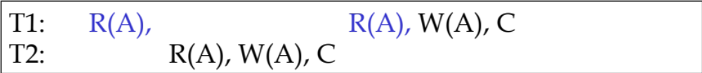
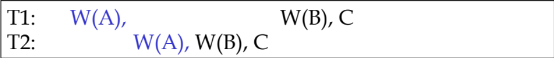
Anomalies with Interleaving
Reading Uncommitted Data (WR Conflicts, “dirty reads”):
e.g. T1: A+100, B+100, T2: A*1.06, B*1.06
Unrepeatable Reads (RW Conflicts):
E.g., T1: R(A), …..R(A), decrement, T2: R(A), decrement
We need schedule that is anomaly-free
Overwriting Uncommitted Data (WW Conflicts):

Slide 19
Our Goal
We need schedule that is equivalent to any serial schedule
It should allow interleaving
Any serial order is good
Produces consistent result & anomaly-free
Given schedule S:
If we can shuffle the non-conflicting actions to reach a serial schedule L
➔ S is equivalent to L
➔ S is good

Slide 20
Example: Schedule C

Slide 21
Example: Schedule C
S_{c}= r1(A) w1(A) r2(A) w2(A) r1(B) w1(B) r2(B) w2(B)
Can be switched because they are not conflicting
S_{c}”= r1(A) w1(A) r1(B) w1(B) r2(A) w2(A) r2(B) w2(B)
T1
T2
➔ Schedule C is equivalent to a serial schedule ➔ So it is “Good”

Slide 22
Why Schedule C turned out to be Good ?
(Some Formalization)
S_{c}= r1(A) w1(A) r2(A) w2(A) r1(B) w1(B) r2(B) w2(B)
T1 → T2
T1 → T2
(T1 precedes T2)
(T1 precedes T2)
 No cycles ⇒ S_{c} is “equivalent” to a
serial schedule where T1 precedes T2.

Slide 23
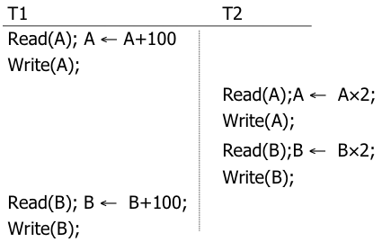
Example: Schedule D
S_{D}= r1(A) w1(A) r2(A) w2(A) r2(B) w2(B) r1(B) w1(B)
Can we shuffle non-conflicting actions to make T1 T2 or T2 T1 ??

Slide 24
Example: Schedule D
S_{D}= r1(A) w1(A) r2(A) w2(A) r2(B) w2(B) r1(B) w1(B)
Can we make T1 first ➔ [T1 T2]?
  No…Cannot move r1(B) w1(B) forward
  Why: because r1(B) conflict with w2(B) so it cannot move….Same for w1(B)

Slide 25
Example: Schedule D
S_{D}= r1(A) w1(A) r2(A) w2(A) r2(B) w2(B) r1(B) w1(B)
Can we make T2 first ➔ [T2 T1]?
  No…Cannot move r2(A) w2(A) forward
  Why: because r2(A) conflict with w1(A) so it cannot move….Same for w2(A)
➔ Schedule D is NOT equivalent to a serial schedule ➔ So it is “Bad”

Slide 26
Why Schedule D turned out to be Bad?
(Some Formalization)
S_{D}= r1(A) w1(A) r2(A) w2(A) r2(B) w2(B) r1(B) w1(B)
T1 → T2
T2 → T1
T1 T2
(T1 precedes T2)
(T2 precedes T1)
Cycle Exist ⇒ S_{D} is “Not equivalent” to any serial schedule.

Slide 27
Recap
Serial Schedules are always “Good” (Consistency + no anomaly)
  But they limit the throughput
Goal: Find interleaving schedule that is “equivalent to” a serial schedule
Identify “Conflicting Actions”, and try to arrange the non-conflicting ones to reach a serial schedule
When formalized ➔ Maps to Dependency Graphs and Cycle Testing
Next…

Slide 28
Definitions
Conflict Equivalent
  S1, S2 are conflict equivalent schedules if S1 can be transformed into S2 by a series of swaps of non-conflicting actions.
Conflict Serializable (Serializable for short)
  A schedule S₁ is conflict serializable if it is conflict equivalent to some serial schedule.
Schedule C is conflict serializable
Schedule D is not conflict serializable

Slide 29
How to Determine This ?
Answer: A Precedence Graph !
If no cycles
If cycles
Schedule is conflict serializable (Good)
Schedule is NOT conflict serializable (Bad)

Slide 30
Precedence Graph P(S) (S is schedule)
Nodes ➔ Transactions in S
Edges ➔ Ti → Tj whenever the 3 conditions are met
- pi(A), qj(A) are actions in S
- pi(A) <_{S} qj(A)
- at least one of pi, qj is a write
Two actions, one from Ti and one from Tj
Ti’s action before Tj’s action
They are conflicting actions

Slide 31
Precedence Graph
Precedence graph for schedule S:
  Nodes: Transactions in S
  Edges: Ti → Tj whenever
    S: … ri (X) … wj (X) …
    S: … wi (X) … rj (X) …
    S: … wi(X) … wj (X) …
Note: not necessarily consecutive

Slide 32
Graph Theory 101
Directed Graph:
Not Cycle
Directed edges
Nodes
Cycle

Slide 33
Theorem
P(S1) acyclic ⇐⇒ S1 conflict serializable

Slide 34
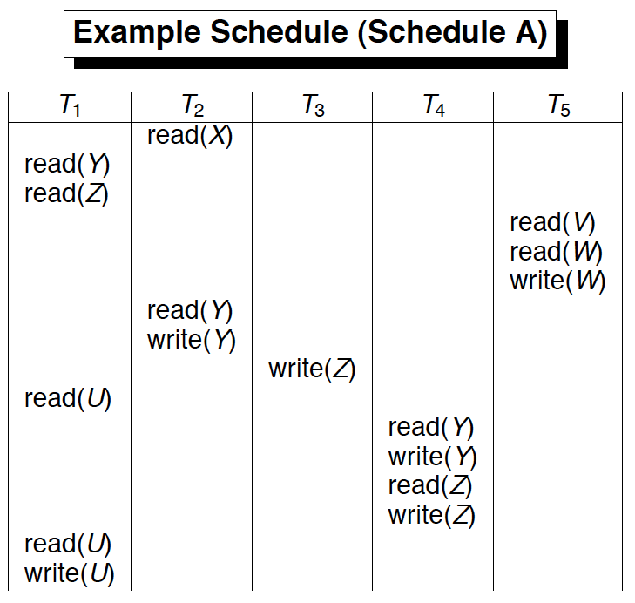
Time dim
r2(x) r1(y) r1(z) r5(v) r5(w) w5(w)….

Slide 35
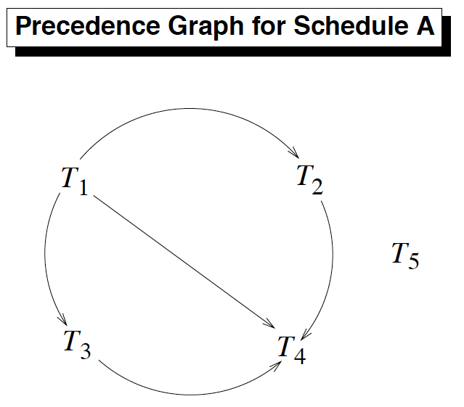
Build P(A)
No cycles
Schedule A is Conflict Serializable

Slide 36
Exercise 1:
What is P(S) for
S = w3(A) w2(C) r1(A) w1(B) r1(C) w2(A) r4(A) w4(D)
Is S conflict-serializable?

Slide 37
Exercise 2:
What is P(S) for
S = w1(A) r2(A) r3(A) w4(A) ?
Is S conflict-serializable?

Slide 38
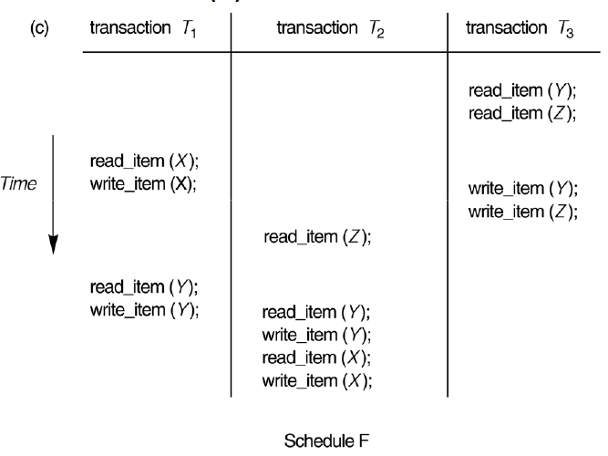
Exercise 3:
Build P(F)….Is F Conflict Serializable ?

Slide 39
How to Find the Equivalent Serial Order
No cycles ➔ Schedule A is Conflict Serializable
So What is the serial order equivalent to A???

Slide 40
How to Find the Equivalent Serial Order
The serializability order can be obtained by a topological sorting of the graph. This is a linear order consistent with the partial order of the graph.
Take the transaction (T) with no incoming edges and put it in the serial order (left–to-right)
Delete T and its edges from the graph
Repeat until all transactions are taken
➔ There can be many orders … It is not unqiue

Slide 41
How to Find the Equivalent Serial Order
One order ➔ T5 T1 T2 T3 T4
Another order ➔ T1 T3 T5 T2 T4
….

Slide 42
Concurrency Control
Enforcing Serializability: Locking

Slide 43
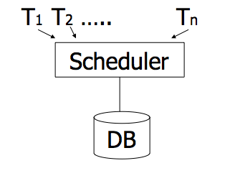
Enforcing Serializable Schedules
DBMSs use a “Scheduler” that schedules the actions of transactions
Transactions send their requests (R or W) to Scheduler
The scheduler prevents the formation of cycles
  It grants permission to R or W only if no cycle will be formed

Slide 44
Locking Protocol
“Scheduler” uses a locking protocol to enforce serializability
Two New actions
  Lock (exclusive): l_{i}(A) ➔ Transaction Ti locks item A
  Unlock: Ui(A) ➔ Transaction Ti unlocks (releases) item A
lock
table

Slide 45
Rule #1: Well-Formed Transactions
Ti: … li(A) … pi(A) … ui(A) ...
Any action (R/W) must be after the lock (l) and before the unlock (u)
Rule 1 is at the level of each transaction independent of the others

Slide 46
Rule #2 Legal Scheduler
S = …….. li(A) ………... ui(A) ……...
no lj(A)
No transaction Tj can lock item A that is already locked by another transaction Ti
(Transaction Tj must wait until Ti releases its lock)
Rule 2 is at the level of the complete schedule (Set of interleaving transactions)

Slide 47
Exercise:
What schedules are legal?
What transactions are well-formed?
  S1 = l1(A)l1(B)r1(A)w1(B)l2(B)u1(A)u1(B) r2(B)w2(B)u2(B)l3(B)r3(B)u3(B)
  S2 = l1(A)r1(A)w1(B)u1(A)u1(B) l2(B)r2(B)w2(B)l3(B)r3(B)u3(B)
  S3 = l1(A)r1(A)u1(A)l1(B)w1(B)u1(B) l2(B)r2(B)w2(B)u2(B)l3(B)r3(B)u3(B)

